Slide 1
Virtual Hawk:
Prototype Testing Pitch
Team Charlie: James Dumitru, Raymond Ezekiel, Bryan Cruz, Sonia Rivas, Mohamad Abu-Rezeq

Slide 2
Problem Statement
A platform that will provide students with a detailed overview of the IIT campus including facilities available, food courts, campus directions, and IIT events.
Important: Freshman and incoming transfer students need a platform to quickly garner useful information about the school.
Chatbox(AI) - 1
App - 2
Website - 3

Slide 3
Key Research Findings
Emphasis on campus events information and consistency/availability of event information updates (name, date & time, building/room location)
Specific features
Efficient search
“Where is my club meeting being held?”
i.e. chatbot interaction
Location details
Specific class numbers
Campus services, i.e. “Career Services” or “One Stop”
Location within a building
Map/directions
Interactive
Click on campus buildings to find classrooms
User feedback

Slide 4
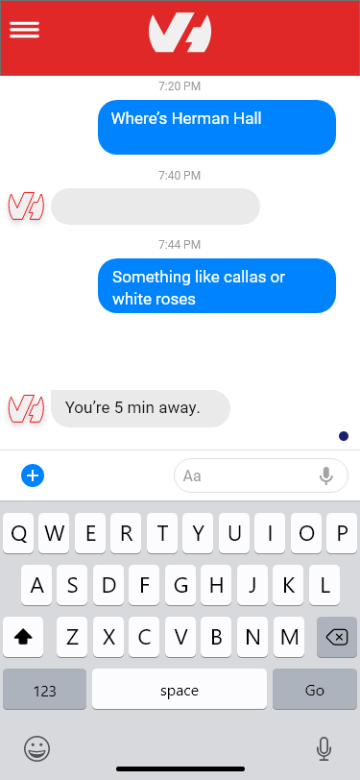
#1 Chatbot
Pros:
More interactive
Direct Feedback
Cons:
Lack of visuals
Simple Data Returns

Slide 5
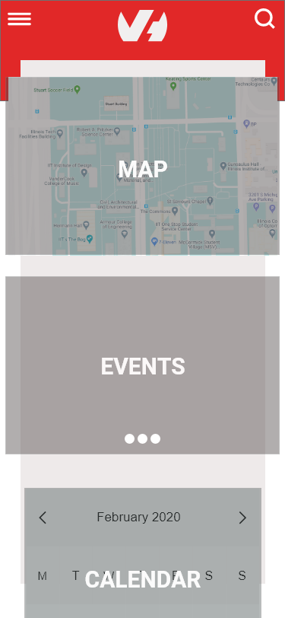
#2 Application
Pros:
Easy navigation
Everything in one place
Cons:
Must download
No where to chat

Slide 6
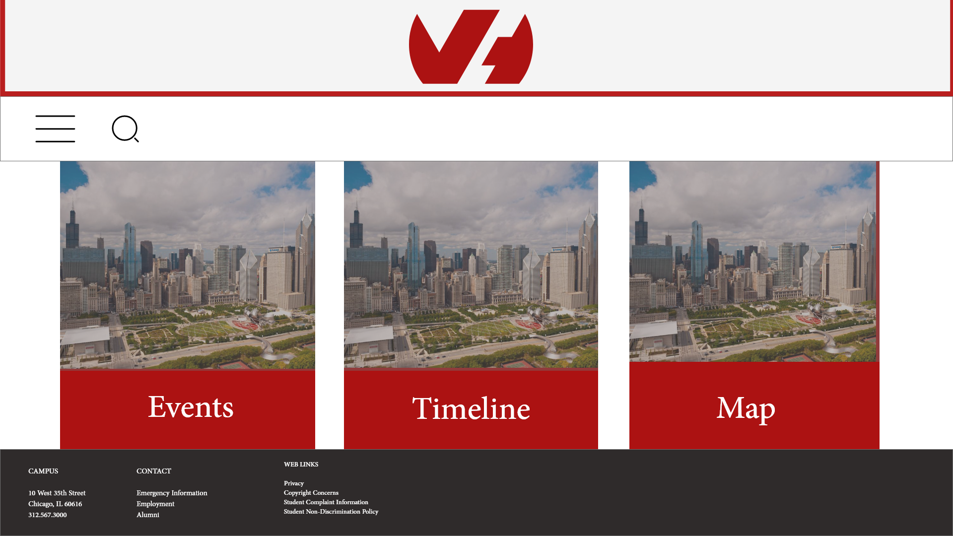
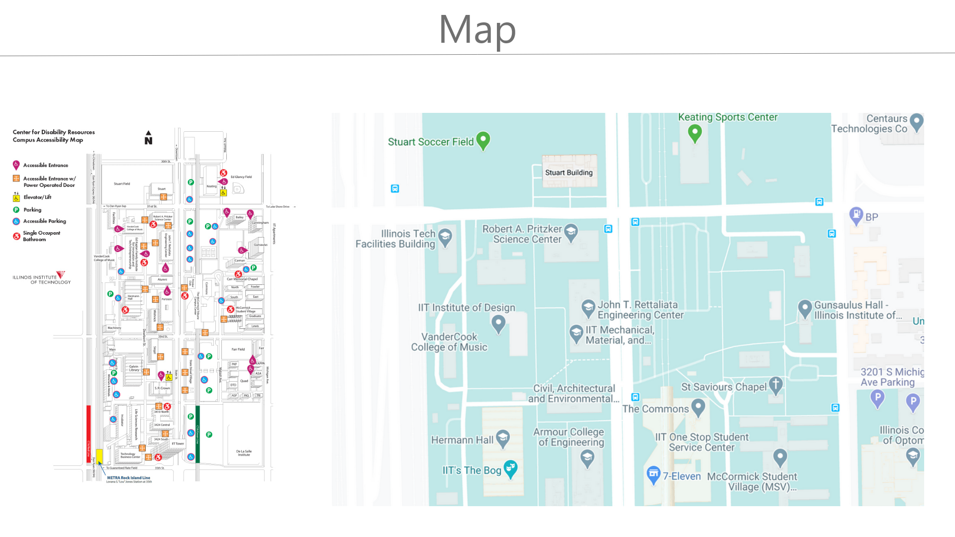
#3 Website
Pros:
Variety of Information
Easy to update - server side
Cross Platform
Cons:
2-D Map

Slide 7

Testing Card for Our Proposed Solutions
Test
Release a application to freshman/transfer students, with all the most relevant data to them in a centralized app.
Metric
Primary metric is successful user data queries vs failed data queries. Secondary metric would include user feedback, retrieved from the application prompting the user to rate their experience.
Criteria
There will be an increased usage on our platform throughout IIT and beyond.

Slide 8
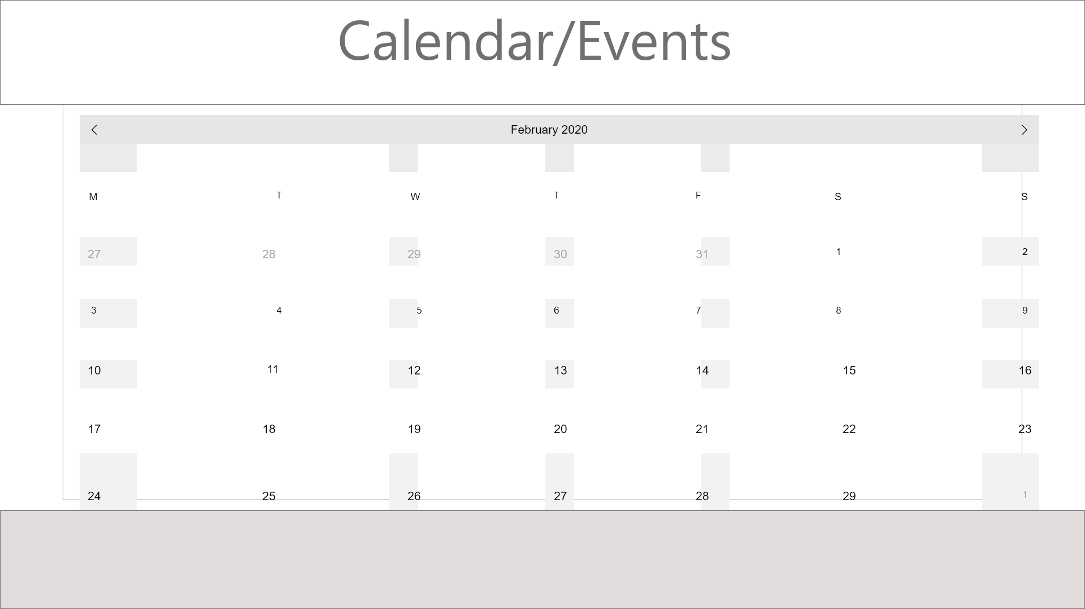
Prototype 3, Website

